Slide 1
PERINGATAN!
Sila ikut langkah seperti dibawah :
Sila masukkan nama penuh, makmal, & no Tel PIC di ruangan Authorised Person In Charge.
Sila print, liminate dan tampal signage di dinding berdekatan dengan simpanan silinder gas.
Sila print, liminate dan sangkut label pada silinder gas dalam setiap makmal. Satu tong satu label.
Sila print colour.
Saiz bagi signage jika boleh saiz A3, jika tidak. A4 sahaja mengcukupi.
Label pula, jangan terlampau kecik, jangan terlampau besar.
Bagi silinder gas yang penuh / sedang digunakan
Bagi silinder gas yang kosong / untuk dipulang kepada pembekal
Bagi silinder gas yang rosak / untuk dipulang pada pembekal

Slide 2
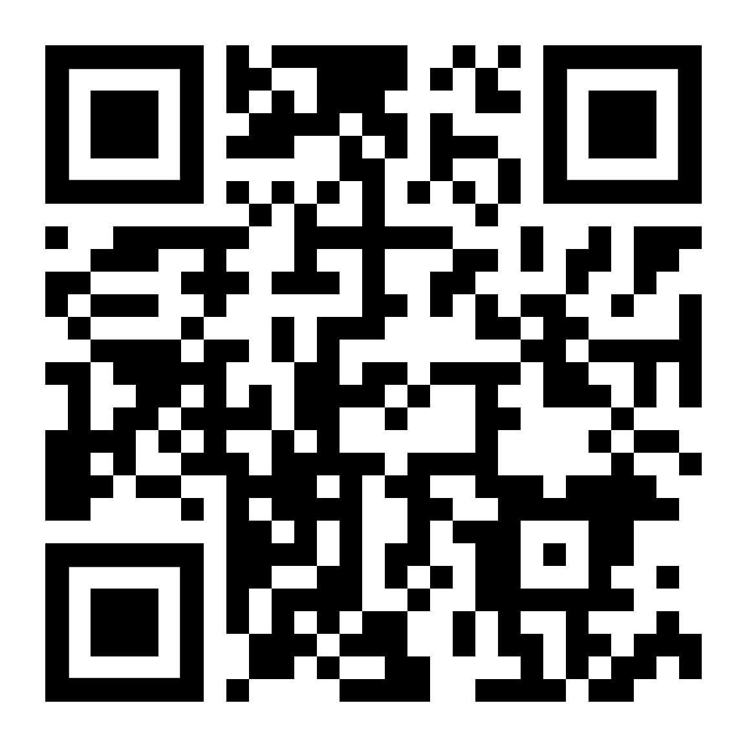
SAFETY FIRST
DANGER : COMPRESSED GAS CYLINDER STORAGE AREA
BAHAYA : RUANG PENYIMPANAN SILINDER GAS MAMPAT
USE PROPER GLOVES
NO SMOKING IN THIS AREA
SAFETY GOGGLES MUST BE WORN
NO NAKED FLAMES
PROTECTIVES FOOTWEAR MUST BE WORN
NO ACCESS TO UNAUTHORISED PERSON
SECURE ALL TANKS, CHAIN CYLINDER
NO PHONE ALLOWED
AUTHORISED PERSON IN CHARGES
NAME :
LABORATORY :
CONTACT NO :
-EASYGAS, CMU (GAS DIVISION), PPMU-

Slide 3
FULL GAS CYLINDER
--------------------------------
READY TO USE
---------------------------------
PLEASE HANG IT ON CYLINDER HEAD
---------------------------------
REFER SDS AND LABEL
---------------------------------
SCAN FOR MORE INFO;
FULL GAS CYLINDER
--------------------------------
READY TO USE
---------------------------------
PLEASE HANG IT ON CYLINDER HEAD
---------------------------------
REFER SDS AND LABEL
---------------------------------
SCAN FOR MORE INFO;
FRONT
BACK

Slide 4
EMPTY GAS CYLINDER
---------------------------------
DO NOT USE
---------------------------------
PLEASE HANG IT ON CYLINDER HEAD
---------------------------------
REFER SDS AND LABEL
---------------------------------
SCAN FOR MORE INFO;
EMPTY GAS CYLINDER
---------------------------------
DO NOT USE
---------------------------------
PLEASE HANG IT ON CYLINDER HEAD
---------------------------------
REFER SDS AND LABEL
---------------------------------
SCAN FOR MORE INFO;
FRONT
BACK

Slide 5
UNDER MAINTENANCE
---------------------------------
DO NOT USE
---------------------------------
PLEASE HANG IT ON CYLINDER HEAD
---------------------------------
REFER SDS AND LABEL
---------------------------------
SCAN FOR MORE INFO;
UNDER MAINTENANCE
---------------------------------
DO NOT USE
---------------------------------
PLEASE HANG IT ON CYLINDER HEAD
---------------------------------
REFER SDS AND LABEL
---------------------------------
SCAN FOR MORE INFO;
FRONT
BACK

